Slide 1

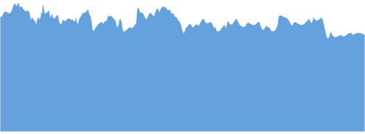










COMPREHENSIVE SALES PERFORMANCE ANALYSIS OF WALMART
By Guardians of the Data

Slide 2






Guardians of the Data
24MBD008
24MBD009
24MBD010
Sonakshi Julka
Srushti Kalambe
Shravani Khadye
Use Case: Analyzing the Impact of Economic Factors on Sales
Techniques Applied: Exploratory Data Analysis (EDA), Principal Component Analysis (PCA), K-Means Clustering, and Regression Model.
Use Case: Analyzing Walmart’s Store Performance.
Techniques Applied:
Exploratory Data Analysis (EDA), Principal Component Analysis (PCA), K-Means Clustering algorithm, and
ANOVA.
Use Case: Analysing Impact of Temperature , Holidays and Seasonal Trends
Techniques Applied: Exploratory Data Analysis (EDA), KDD,K-Means Clustering, Sesonal Trend Analysis

Slide 3

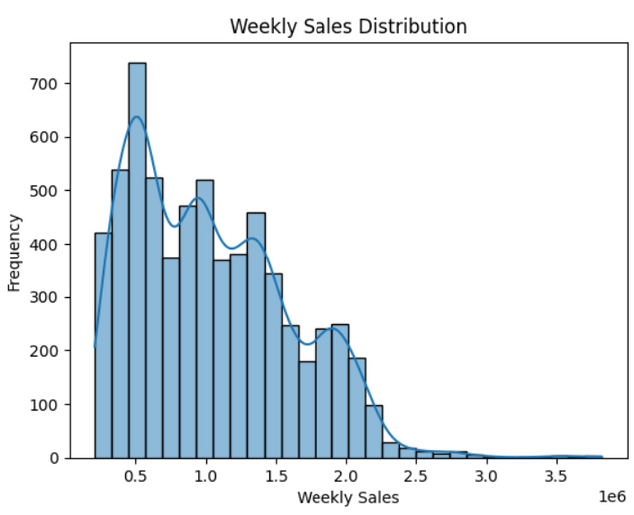
Introduction
Retail success depends on multiple factors, including economic indicators, seasonal trends, and external influences such as temperature and holidays. Understanding these patterns allows businesses to make informed decisions for better sales forecasting and resource management.
This project focuses on predicting Walmart store sales using regression analysis while also analyzing the impact of temperature, holidays, and seasonal trends.
By applying Exploratory Data Analysis (EDA), Knowledge Discovery in Databases (KDD), K-Means Clustering, and Seasonal Trend Analysis, we aim to uncover hidden patterns in sales data.
Additionally, Principal Component Analysis (PCA) is used for dimensionality reduction, and clustering helps identify store performance trends.
These insights can help Walmart optimize inventory planning, staffing, and promotions based on seasonal demand shifts.

Slide 4

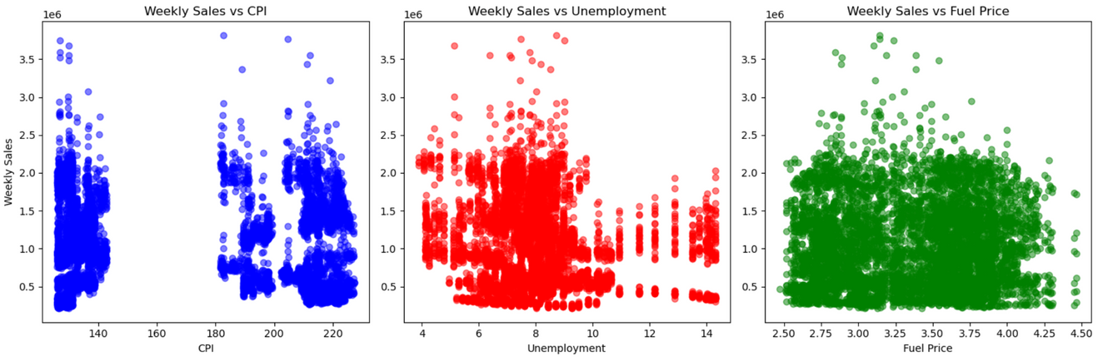
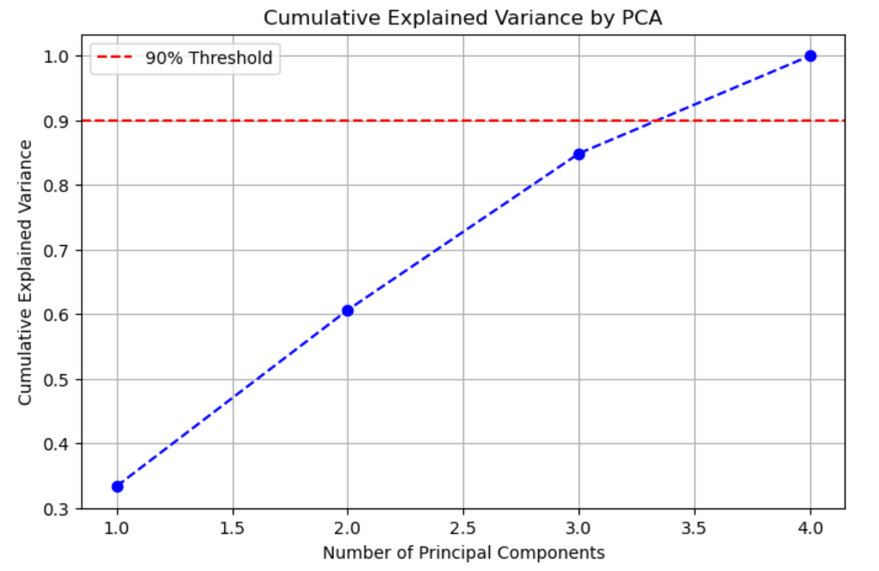
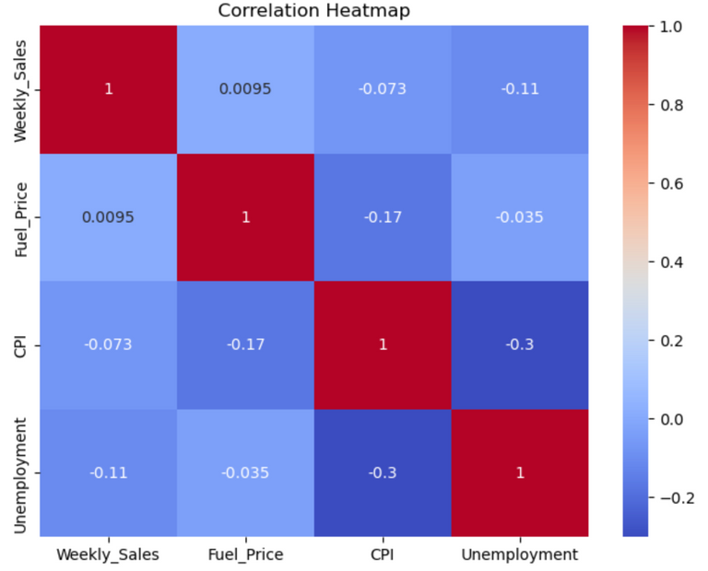
Effect of Economic Factors on Sales
01
Exploratory Data Analysis (EDA)
02
Principal Component Analysis (PCA) on Economic Factors
This plot helps in dimensionality reduction by identifying the minimum number of components required to capture most of the information in the dataset. In this case, keeping 3 principal components would be a reasonable choice as it explains around 90% of the variance while reducing the data dimensions.

Slide 5
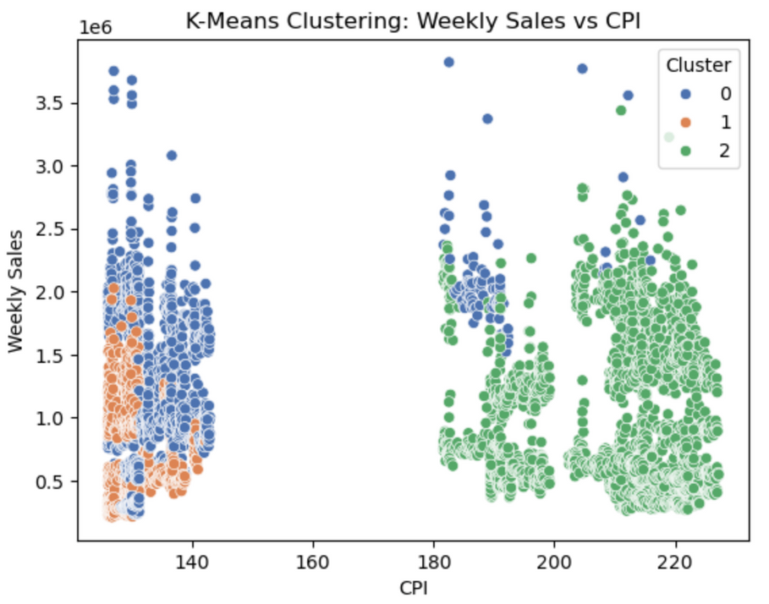
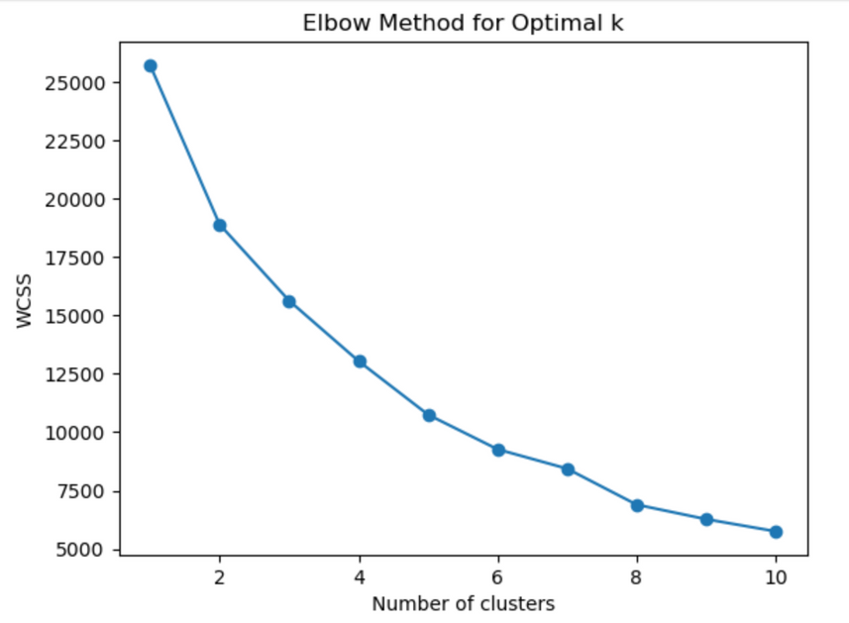
Effect of Economic Factors on Sales
03
K-Means Clustering
(B) The K-Means Clustered Scatter Plot
(A) The Elbow Method Plot
Potential Business Strategy Based on Clusters
Walmart can optimize pricing and marketing strategies for different locations based on CPI.
Stores in high-CPI areas might need premium product strategies.
Stores in low-CPI areas might benefit from discounts and bulk sales promotions.
The "elbow point" is where the inertia stops decreasing sharply, indicating the best choice for k. In this case the value for k = 3.
Sales Behavior Differs by CPI
Stores in lower CPI areas have lower sales.
Stores in high CPI areas tend to have higher sales.

Slide 6
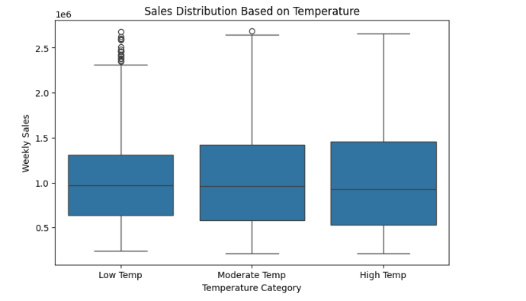
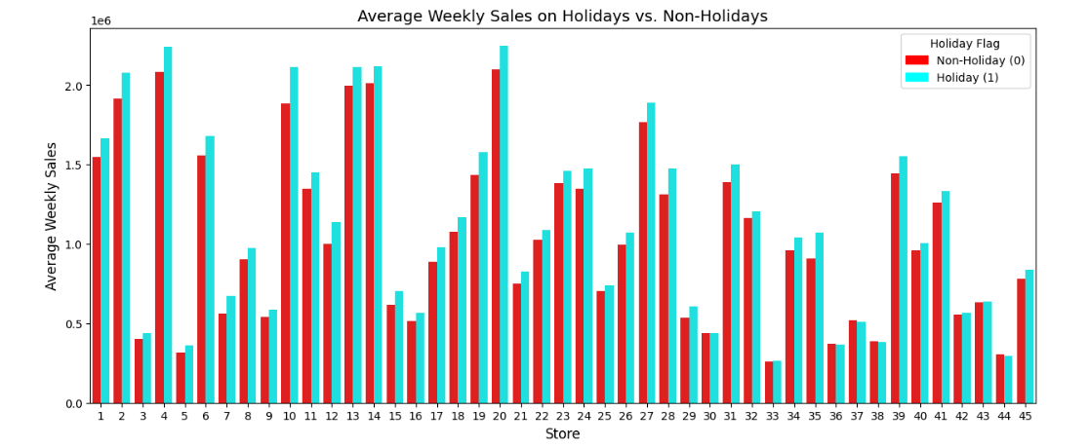
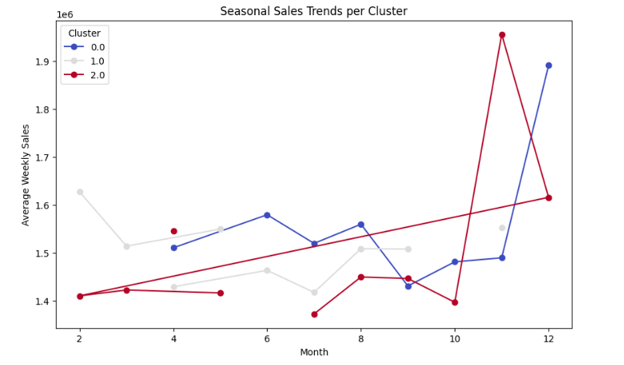
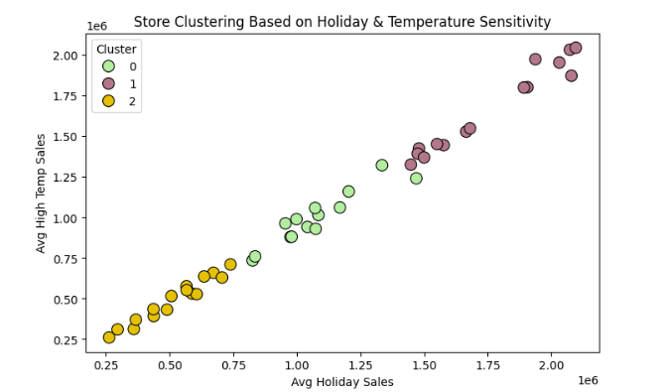

Sales Analysis Based on Holiday, Non-Holiday and Temperature
01
Exploratory Data Analysis (EDA)
02
Clustering based on Holidays and Seasonality

Slide 7
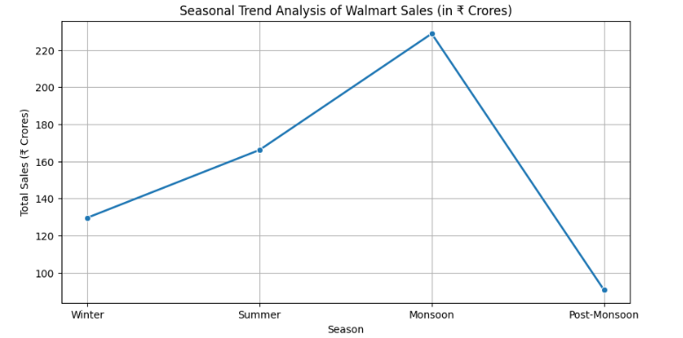
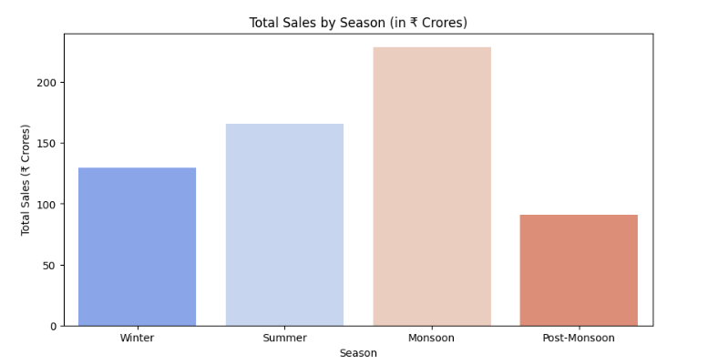
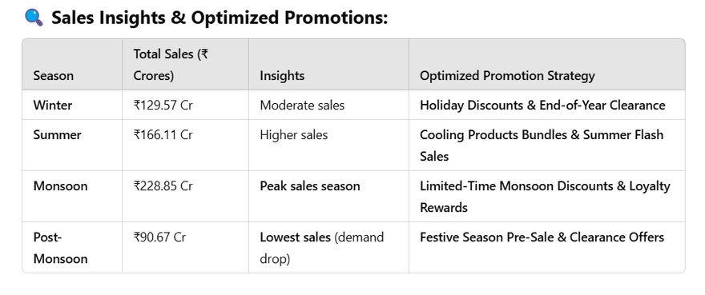
Seasonal Trend Analysis
03
Time Series Analysis
Different seasons show distinct buying patterns, suggesting that Walmart could optimize marketing strategies based on seasonal demand.
Sales peak in the monsoon season, crossing ₹220 Cr, indicating a significant increase in consumer demand.
Sales drop drastically in the post-monsoon season, reaching the lowest at ~₹90 Cr, suggesting reduced shopping activity.
04
Business Intelligence & Strategy

Slide 8
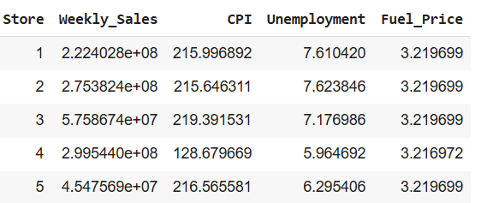
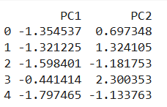
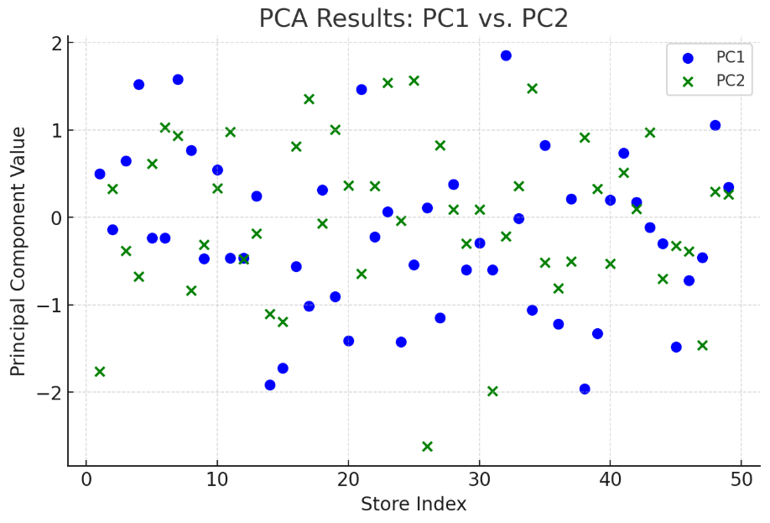

Clustering stores into successful vs. struggling
01
Standardization of data
02
Principal Component Analysis (PCA)
PC1 captures the most variance in store success patterns.
PC2 captures the second-most variance, uncorrelated to PC1.
Helps in K-Means clustering, as stores are now grouped based on PC1 and PC2 rather than many original variables.
Data is converted into standardized dataset, meaning all the features are scaled to have mean=0 & variance=1

Slide 9
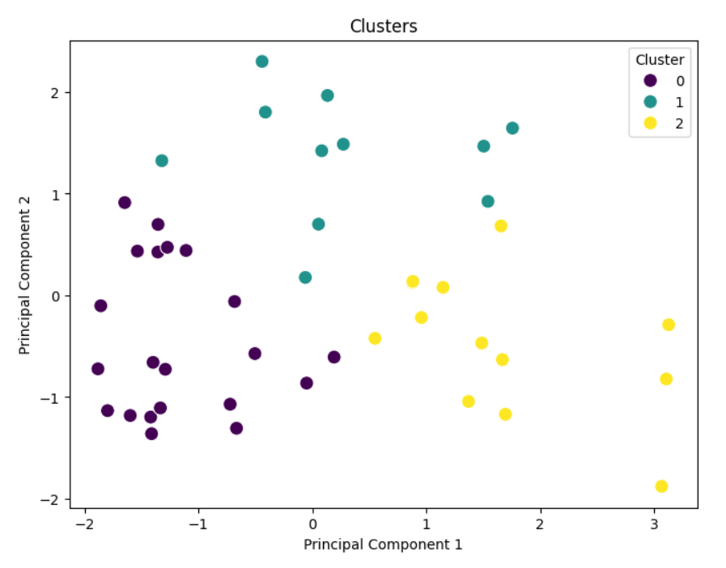
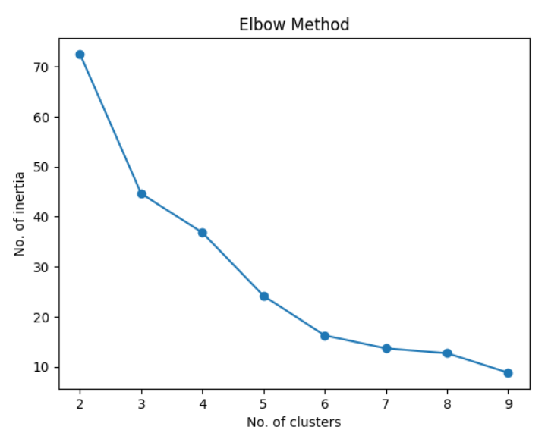
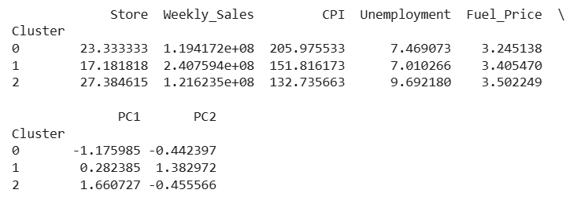

Clustering stores into successful vs. struggling
03
Elbow method
for ideal no. of clusters
04
KMeans Clustering
As per this graph the ideal no. of clusters to be made are 3.
Centroid of the cluster:

Slide 10
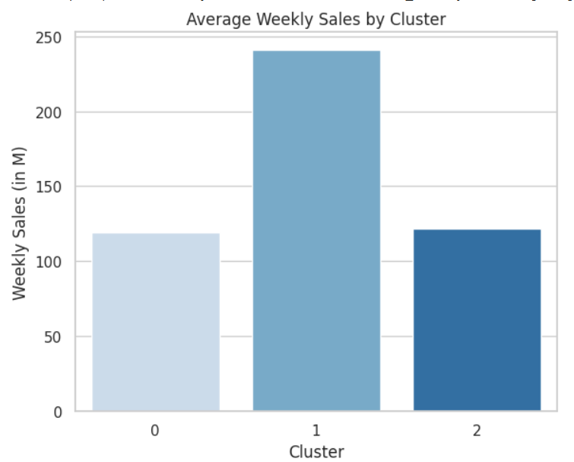
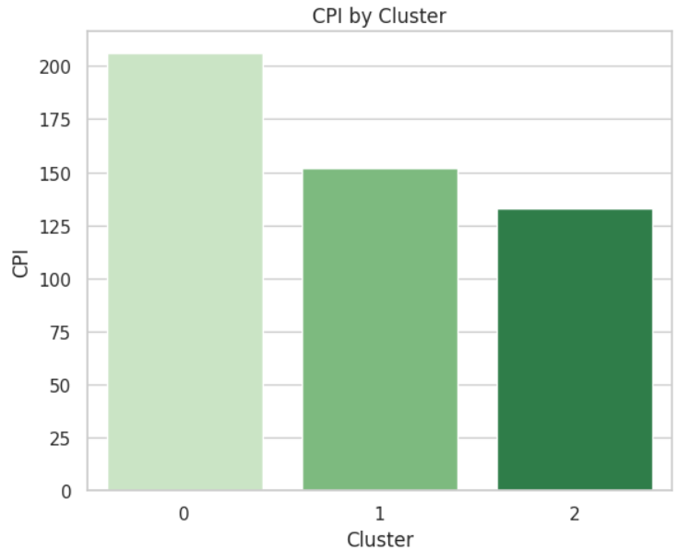
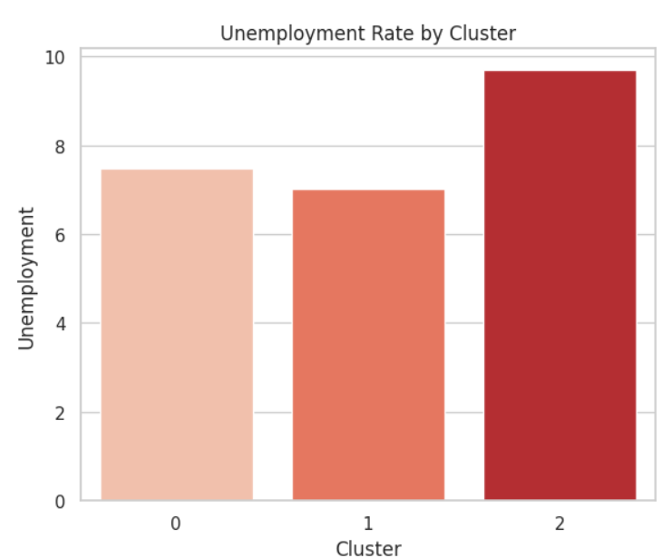
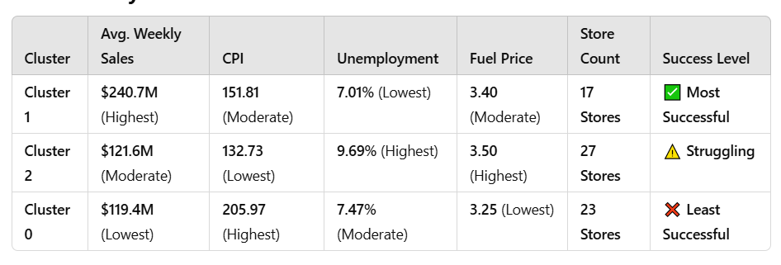
Clustering stores into successful vs. struggling

Slide 11
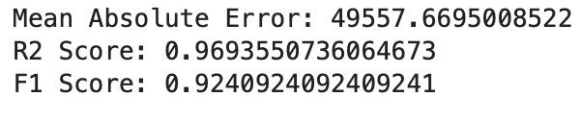
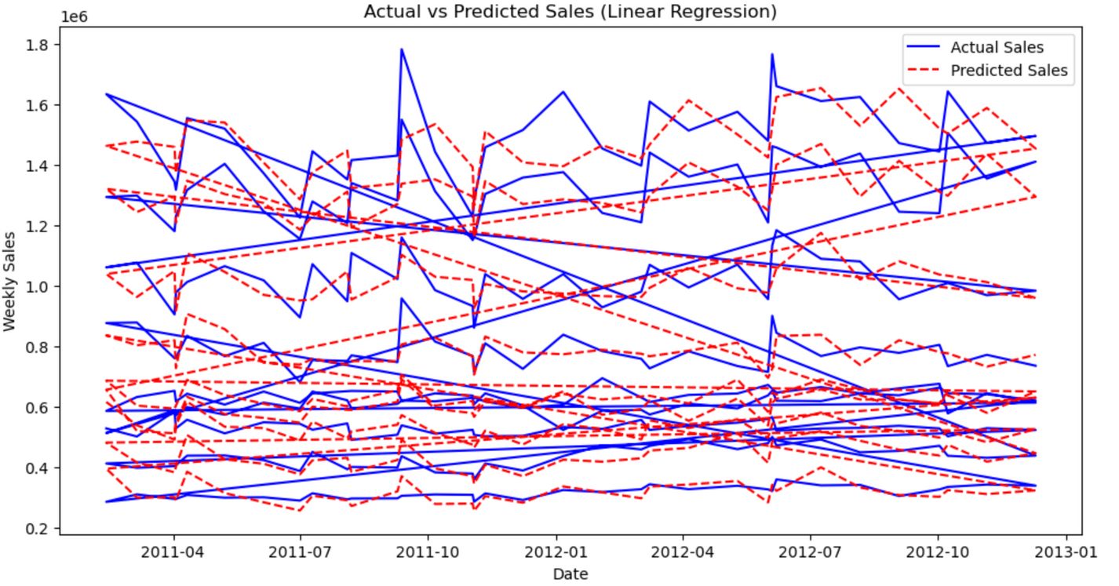
Walmart Sales Forecasting
04
Linear Regression model
Mean Absolute Error: On average, our predictions deviate from actual sales by around 49,557 units of sales revenue.
R² Score: This indicates that 96.9% of the variance in weekly sales is explained by the model, signifying strong predictive capability.
F1 Score: Shows that the model is good at classifying whether sales will increase or decrease, which is important for business decisions.
The model effectively captures long-term trends and overall sales patterns.
Some stores show stable sales patterns, making them easier to predict
Other stores have highly volatile sales, where predictions deviate significantly from actual values.
Predictions align well with actual sales for stores with consistent sales trends.

Slide 12
Conclusion
Our Walmart sales forecasting model using Linear Regression achieves an R² of 96.9%, with an average prediction error of 49,557 sales units. PCA reveals that 3 components capture 90% variance, aiding dimensionality reduction. Higher CPI areas show increased sales, while lower CPI areas see reduced sales. K-Means clustering suggests optimizing pricing—premium products for high-CPI areas and discounts for low-CPI areas.
Holidays boost sales (time-series analysis), aiding promotions and inventory planning. Box plots show temperature-based sales variations, guiding weather-specific marketing. K-Means clustering identifies seasonal sales patterns, enabling data-driven forecasting and tailored store strategies.
Using PCA and K-Means Clustering, we streamlined sales and economic data, revealing key store performance patterns. Cluster 1 represents the most successful stores with high sales and stable conditions, Cluster 2 has average sales, and Cluster 0 includes struggling stores with lower sales and economic instability.

